Slide 1

SoK: Arbitrage and Attack Strategies in DeFi
CS6290 Privacy-enhancing Technologies
April ,2025
Xinyue Liu 刘馨月(72403625@cityu-dg.edu.cn)
Hongzhi Liu 刘虹志(72403035@cityu-dg.edu.cn)
Xingyu Chen 陈星宇(72401656@cityu-dg.edu.cn)
Qiulin Su 苏秋林(72405483@cityu-dg.edu.cn)
Chongyu Chang 常崇昱(72403895@cityu-dg.edu.cn)-Audit Student

Slide 2
Contents
DeFi Primitives & Background
DeFi Arbitrage Strategies
DeFi Attack Strategies
DeFi Defenses Mechanisms
Conclusion

Slide 3
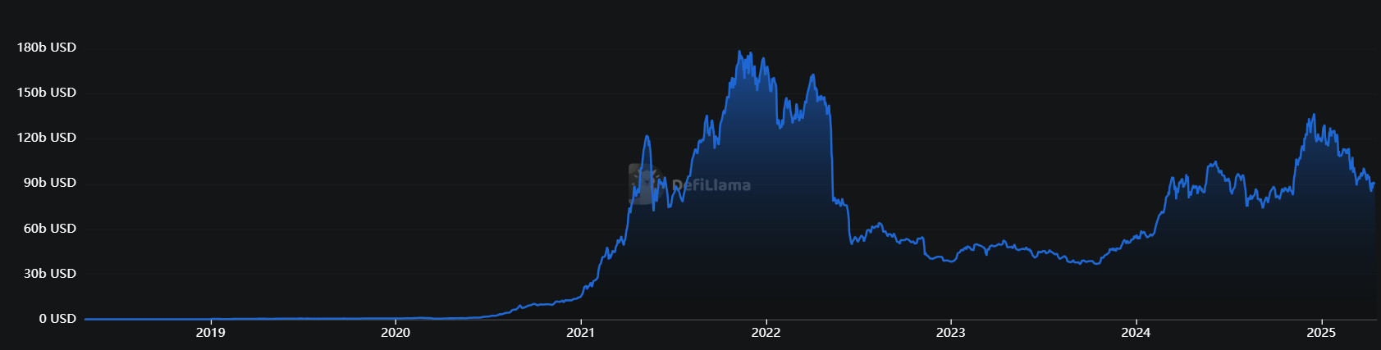
DeFi Primitives & Background
Decentralized Finance (DeFi), a blockchain powered peer-to-peer financial system, enabling permissionless financial services through smart contracts.
Total Value Locked in DeFi: $96.131b
Data source: DeFiLlama (https://defillama.com)
Notes:
DeFi's innovation also introduces new risks, notably various forms of arbitrage and attack strategies that threaten the security and stability of DeFi protocols.
This chart shows the change in DeFi Total Value Locked (TVL) since 2019, peaking in 2021-2022 before declining, and currently around $96.1 billion.

Slide 4
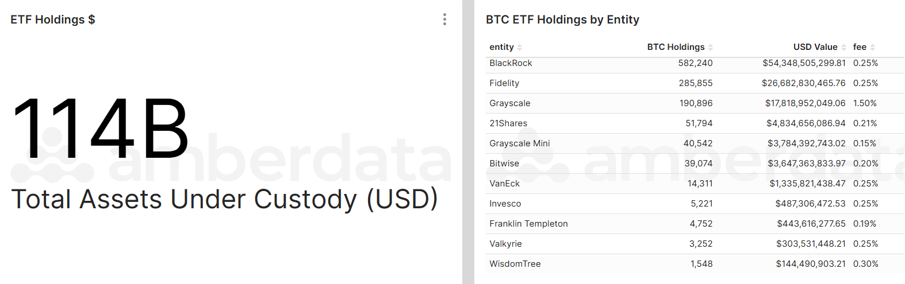
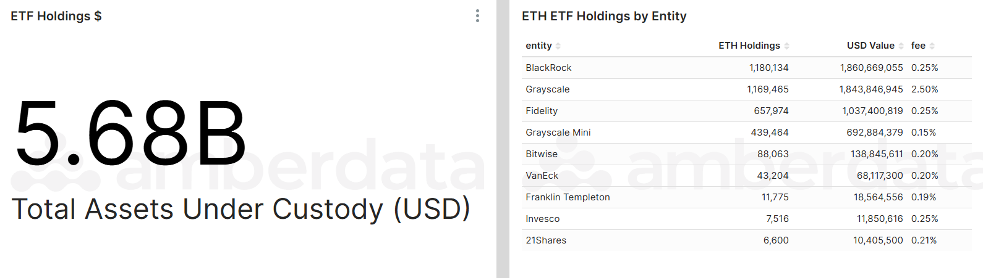
DeFi Primitives & Background
BTC
ETH
Data source: AmberLens (https://intelligence.amberdata.com)
Notes:
The total assets under custody for BTC and ETH ETFs, as reported by Amberdata ($114B for BTC ETFs and $5.68B for ETH ETFs), reflect the large-scale institutional and traditional finance participation in crypto through regulated products, while the Total Value Locked (TVL) in DeFi protocols, as shown on DeFiLlama ($96.13B), represents the value of assets actively engaged in decentralized financial applications on-chain. The ETF holdings are higher because they aggregate significant institutional capital seeking regulated, lower-risk exposure, whereas DeFi TVL measures only the assets directly utilized in decentralized protocols, which involves higher risk and technical barriers, and is primarily driven by crypto-native users. Thus, ETF holdings and DeFi TVL capture different segments of the crypto ecosystem, with ETF holdings generally exceeding DeFi TVL due to broader institutional adoption and different use cases. BlackRock, Grayscale, and Fidelity dominate both BTC and ETH ETF holdings, with BlackRock leading in total assets under custody for both cryptocurrencies.

Slide 5
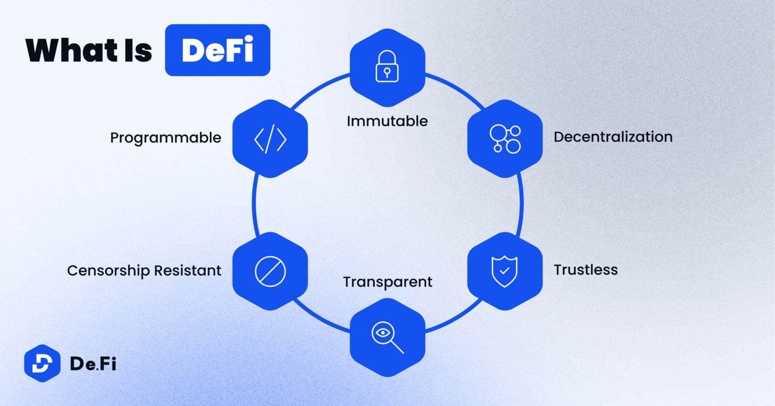
DeFi Primitives & Background
DeFi, in its ideal form, exhibits four properties.
Non-custodial
Permissionless
Openly auditable
Composable
Notes:
(1) Non-custodial: participants have full control over their funds at any point in time
(2) Permissionless: anyone can interact with financial services without being censored or blocked by a third party
(3) Openly auditable: anyone can audit the state of the system, e.g., to verify that it is healthy
(4) Composable: its financial services can be arbitrarily composed such that new financial products and services can be created (similar to how one is able to conceive new Lego models based on a few basic building blocks)

Slide 6
DeFi Primitives & Background
There are four primitives in DeFi:
Smart Contracts are self-executing programs deployed on blockchains, which automatically enforce the rules and logic of financial agreements without the need for trusted intermediaries.
Oracles act as bridges between the blockchain and the external world, supplying smart contracts with off-chain data such as asset prices and real-world events.
Keepers are automated actors responsible for triggering on-chain actions either periodically or in response to specific conditions.
Governance mechanisms empower the community to make decisions regarding protocol parameters, upgrades, and resource allocation.
Notes:
There are four primitives in DeFi: Smart Contracts are self-executing programs deployed on blockchains, which automatically enforce the rules and logic of financial agreements without the need for trusted intermediaries. Oracles act as bridges between the blockchain and the external world, supplying smart contracts with off-chain data such as asset prices and real-world events. Keepers are automated actors responsible for triggering on-chain actions either periodically or in response to specific conditions Governance mechanisms empower the community to make decisions regarding protocol parameters, upgrades, and resource allocation. These primitives work in concert to provide the foundational infrastructure for the DeFi ecosystem. They ensure that protocols are automated, self-governing, and open, while also enabling further innovation and the composition of increasingly complex financial applications

Slide 7
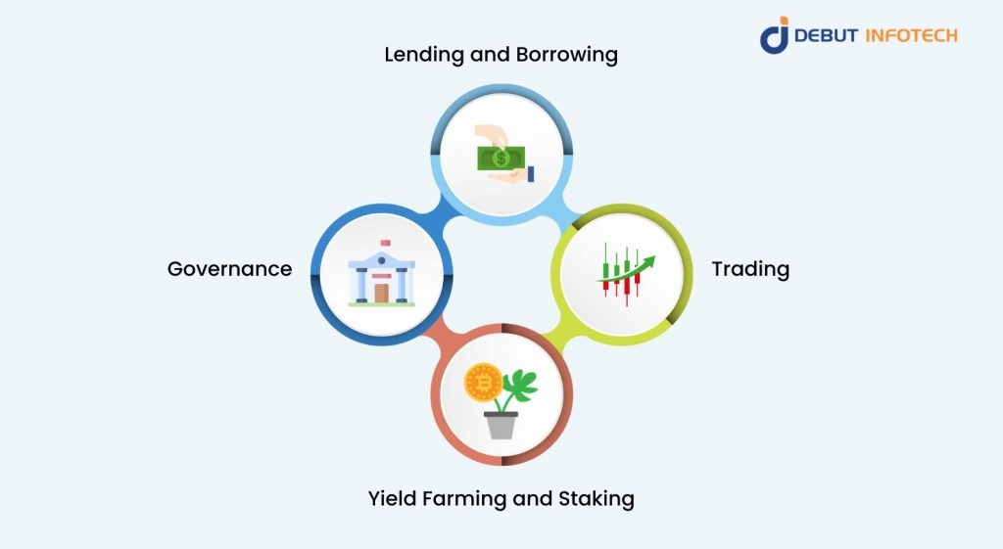
DeFi Primitives & Background
DeFi foundational infrastructure includes public blockchains (e.g., Ethereum), decentralized identity management, and secure wallet solutions
On top of this infrastructure, several categories of core protocols have emerged as the backbone of DeFi:
Automated Market Makers (AMMs)
Lending Protocols
Asset Management and Aggregators
Stablecoin Protocols
Notes:
The DeFi ecosystem is supported by a robust infrastructure and a diverse set of core protocols that facilitate decentralized financial activities. The foundational infrastructure includes public blockchains (e.g., Ethereum), decentralized identity management, and secure wallet solutions On top of this infrastructure, several categories of core protocols have emerged as the backbone of DeFi: {Automated Market Makers (AMMs):} AMMs have revolutionized decentralized trading by eliminating the need for order books and centralized market makers. Instead, they utilize liquidity pools and mathematical formulas to automatically determine asset prices and facilitate swaps {Lending Protocols:} Decentralized lending protocols enable users to lend and borrow digital assets in a permissionless manner. These protocols use smart contracts to manage collateral, calculate interest rates, and execute liquidations, thereby reducing counterparty risk {Stablecoin Protocols:} Stablecoins play a vital role in mitigating the volatility of cryptocurrencies by maintaining a stable value. These protocols employ various mechanisms, such as collateralization and algorithmic supply adjustments, to achieve price stability.
f{Asset Management and Aggregators:} Asset management protocols offer yield optimization, automated portfolio management, and efficient routing of trades across multiple DeFi platforms~.

Slide 8

DeFi Primitives & Background
The Grey Area Between Arbitrage and Attack
Poly Network attack, the attacker exploited and stole assets, earning a $500000 vulnerability bounty and retaining the title of "Chief Security Advisor" granted by the project team.
Mango Markets incident, attackers profited by manipulating oracle prices and cited protocol autonomy rules to defend themselves
From an ethical perspective, the universalization of Sandwich Attack has sparked deeper thinking. What's even more tricky is that such strategies are often in a gray area of the existing legal system - they strictly follow protocol rules but clearly violate fair trade principles.
Notes:
In the DeFi field, the boundary between arbitrage and attack is often blurred. In the Poly Network attack, the attacker exploited and stole assets, ultimately earning a $500000 vulnerability bounty and retaining the title of "Chief Security Advisor" granted by the project team. This incident has sparked a heated debate about the standard of 'ethical hacking', which could set a dangerous precedent by legitimizing theft. In the Mango Markets incident, attackers profited by manipulating oracle prices and cited protocol autonomy rules to defend themselves, exposing a fatal flaw in DeFi governance mechanisms: the lack of an authoritative arbitration framework when technical feasibility, community governance, and legal norms conflict From an ethical perspective, the universalization of Sandwich Attack has sparked deeper thinking. About 23% of MEV profits on Ethereum in 2023 come from this strategy that harms the interests of ordinary users, and when participants are informed that their arbitrage behavior will result in losses for others, 78% still choose to continue executing it, reflecting the role of DeFi anonymity in dissolving ethical constraints. What's even more tricky is that such strategies are often in a gray area of the existing legal system - they strictly follow protocol rules but clearly violate fair trade principles. Next, please let Xinyue talk about the DeFi arbitrage strategy

Slide 9
Contents
DeFi Primitives & Background
DeFi Arbitrage Strategies
DeFi Attack Strategies
DeFi Defenses Mechanisms
Conclusion

Slide 10
DeFi Arbitrage Strategies
Define: Utilizing price differences between different protocols/markets to achieve risk-free or low-risk profits.
Relying on the openness, permissionless, and composability of blockchain.
Category:
✅ Cross-Platform Arbitrage:
The price difference of the same asset between different DEX/lending agreements
✅ Triangle arbitrage:
Make profits through cyclic trading of three or more assets
✅ Flash Loan Arbitrage:
Zero principal atomization operation
✅ Oracle-Based Arbitrage:
Utilize price update delay
✅ Emerging Arbitrage Forms:
Cross chain arbitrage, MEV strategy, etc.
Notes:
DeFi Arbitrage Strategies utilize price differences between different protocols/markets to achieve risk-free or low-risk profits.
We will conduct research from the following five categories.

Slide 11
DeFi Arbitrage Strategies
Cross-Platform Arbitrage
Core mechanism
Real time monitoring of 50+DEX prices (Uniswap/Curve, etc.)
Atomic transaction execution (success rate of 92%)
classic case
2020 DAI at Curve Premium of 3% (72 hour Arbitrage of $8M)
Risk Matrix
Gas competition (cost increased by 60%) Front end attack (occurrence rate 28%)
Price Monitoring
Spread Detection
Atomic Trading Execution
Profit Settlement
Cross-Platform Arbitrage flow chart (Time cycle<500ms)
Notes:
Cross-platform arbitrage achieves profitability by comparing the asset price differences of different DEX in real-time.
It demonstrates the efficiency of the DeFi market, although reducing price deviations, this strategy significantly increase network congestion and gas costs.

Slide 12
DeFi Arbitrage Strategies
Triangular Arbitrage
Path construction algorithm
Bellman Ford Improved Version for Detecting Negative Weight Rings
Dynamically calculate sliding point/Gas cost
Case Comparison
✔️ BZx attack (profit 1193 ETH) ✖️ Normal path failure rate 42% (due to slippage)
Market impact
Improve price consistency (deviation ↓ 81%)
Consume 15% of network gas resources
ETH
DAI
USDC
Triangular Arbitrage Path Map
Notes:
Triangular Arbitrage profits by identifying exchange rate imbalances between three trading pairs.
It improves market efficiency by reducing price inconsistency, but at the cost of consuming network resources.
The high failure rate caused by slippage indicates the limitations in volatile markets.

Slide 13
DeFi Arbitrage Strategies
Flash Loan Arbitrage
Technical feature
Unsecured atomic operation (borrowing transaction repayment)
Average return rate of 300-800% per transaction
Classic case
BZx attack ($1M profit)
PancakeSwap cross chain arbitrage (3.5% return)
Systemic risk
32% of transactions failed due to contract vulnerabilities
Involving 5.7 protocols/time
T0: Borrowing
T1: Arbitrage Operation
T2: Repayment
Flash Loan Sequence Chart (must be T2>T1, otherwise full rollback)
Notes:
Flash Loan Arbitrage completes unsecured leverage operations through a single transaction.
It implements complex strategies with high capital efficiency, achieving high returns.
But the failure rate and transaction protocol have formed a complex risk transmission path, revealing its systemic risk.

Slide 14
DeFi Arbitrage Strategies
Oracle-Based Arbitrage
Attack mode
Time difference arbitrage (Chainlink vs OSM latency)
TWAP manipulation (Alpha Finance loss of $36M)
Defense measures
Multi data source validation (such as MakerDAO)
Outlier detection algorithm
Single Data Source
Chainlink+Band+Uniswap TWAP
× Manipulated
√ Security
Oracle Data Flow Comparison Chart
Notes:
Oracle-Based Arbitrage uses price update delays or data vulnerabilities to profit.
Although multi data source validation reduced the success rate,
the increased latency revealed a fundamental trade-off between security and efficiency in oracle design.

Slide 15
DeFi Arbitrage Strategies
Emerging Arbitrage Forms
Innovation strategy
Multi chain arbitrage (Ethereum ARM spread)
MEV arbitrage (sandwich attacks account for 68%)
Technical challenges
Cross chain atomicity (success rate<50%)
Validators collude with risks
Ethereum buy at low price
Cross chain bridge transfer
Arbitrarum sell at high price
Cross chain arbitrage process diagram
Notes:
Emerging arbitrage strategies face more complex technical challenges.
The regulation of these strategies is still blank, and a new framework for cross chain atomicity and fair distribution of MEVs needs to be established.

Slide 16
DeFi Arbitrage Strategies
Strategy Type | Key Risks | Returns & Quantitative Metrics
Cross-Platform Arbitrage | Policy risks, withdrawal delays, exchange rate fluctuations | Annualized return 10%-30%, impacted by fees (0.1%-0.5%) and slippage (1%-5%)
Triangular Arbitrage | Slippage, MEV front-running, transaction failure | Single trade profit 0.5%-2%, HFT annualized return >50%
Flash Loan Arbitrage | Smart contract vulnerabilities, timeout risks, high gas fees | Leverage amplifies returns 10-100x, annualized return >200%
Oracle Arbitrage | Data reliability, contract logic flaws | High volatility (20%-100% annualized), depends on market volatility
Cross-Chain Arbitrage | Bridge security risks, network congestion, chain fee differences | Annualized return 15%-40%, per operation 5-30 mins
MEV-Driven Arbitrage | High gas competition, regulatory risks, ethical concerns | Single trade profit 0.1%-3%, HFT annualized return >300%
Notes:
This is a quantitative comparison of various strategies.
The most noteworthy aspect is that the high success rate of MEV strategy is based on harming user interests, which has sparked ethical controversies about the fairness of decentralized system markets.
In the future, it is necessary to establish a unified risk framework and address systemic impacts.

Slide 17
Contents
DeFi Primitives & Background
DeFi Arbitrage Strategies
DeFi Attack Strategies
DeFi Defenses Mechanisms
Conclusion

Slide 18
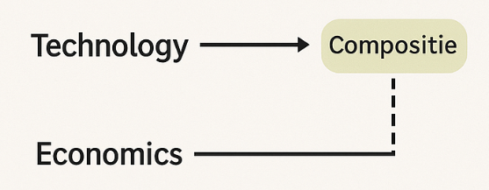
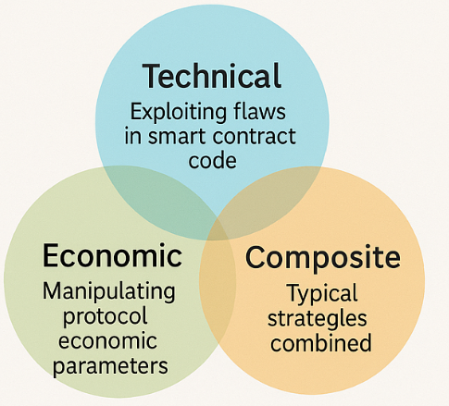
Types and Evolution of DeFi Attacks
Multidimensional Paradigms of DeFi Attacks: Technology, Economics, and Composability
Content Structure:
Technical Attacks: Exploiting flaws in smart contract code (e.g., reentrancy, unchecked calls).
Economic Attacks: Manipulating protocol economic parameters (e.g., price feeds, governance weight).
Composite Attacks: Hybrid strategies, such as using flash loans for price manipulation + governance exploits.
DeFi attacks are no longer purely technical breaches; they represent a composite attack vector combining semantic vulnerabilities in smart contracts with game-theoretic flaws in protocol design.
Notes:
I’ll start by introducing the multidimensional paradigm of DeFi attacks.
DeFi attacks now fall into three categories: technical, economic, and ’composite.
They’ve evolved from isolated exploits to cross-layer, cross-mechanism strategies, creating bigger security challenges for protocol design. DeFi 攻击类型与演化趋势 🎯 标题：DeFi攻击的多维范式：技术、经济与组合性 📌 内容结构： • 技术攻击：依赖智能合约代码缺陷（如重入、未检查调用）。 • 经济攻击：操纵协议经济参数（如价格、治理权重）。 • 复合攻击：典型策略融合，如闪电贷用于价格操控 + 治理攻击。 🎓 关键见解（学术视角）：
“DeFi攻击不再是纯粹的技术入侵，而是兼具智能合约语义漏洞与协议机制博弈漏洞的组合型攻击向量。”

Slide 19
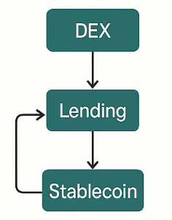
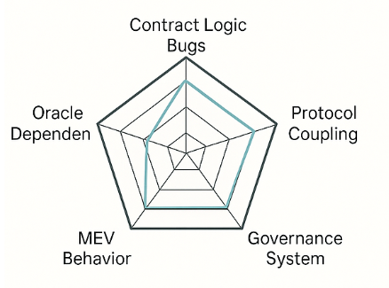
Attack Surfaces and Amplification Mechanisms
📌 Attack Surface Overview:
Contract Logic Flaws: Function permission misconfigurations, faulty inheritance structures
Oracle Dependencies: Price manipulation, low-liquidity exploits
MEV Behaviors: Front-running, sandwich attacks
Governance Systems: Low voting thresholds, flash loan-based proposals
Protocol Coupling: Trust propagation issues in inter-protocol calls
High interdependence among DeFi protocols acts as a risk amplifier—localized vulnerabilities can cascade through call chains, triggering systemic shocks that mirror the complex dynamics of financial networks.
Notes:
Next, I’ll talk about DeFi’s weak spots and how small issues can grow.
Since DeFi protocols are closely linked, even a minor flaw can spread through connected actions and cause bigger problems across the system.
This shows how DeFi works like a complex web, making it harder to keep the whole system secure. PPT 第2页：五类关键攻击面与系统性风险路径 🎯 标题：DeFi系统性脆弱性分析：攻击面与放大机制 📌 攻击面简析： • 合约逻辑漏洞（函数权限、错误继承） • 预言机依赖（价格操纵、低流动性攻击） • MEV行为（抢先交易、三明治攻击） • 治理系统（低投票门槛、闪电贷提案） • 协议耦合性（跨协议调用中的信任传递问题） 🎓 关键见解（学术视角）：
“DeFi协议之间的高耦合性构成攻击风险的放大器，局部漏洞可通过调用链放大为系统性冲击，体现出典型的金融网络复杂性特征。”

Slide 20
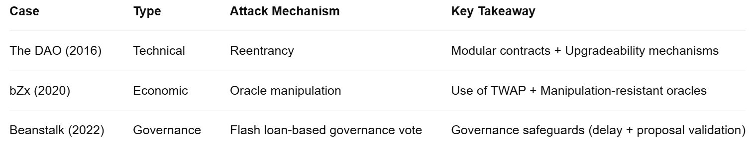
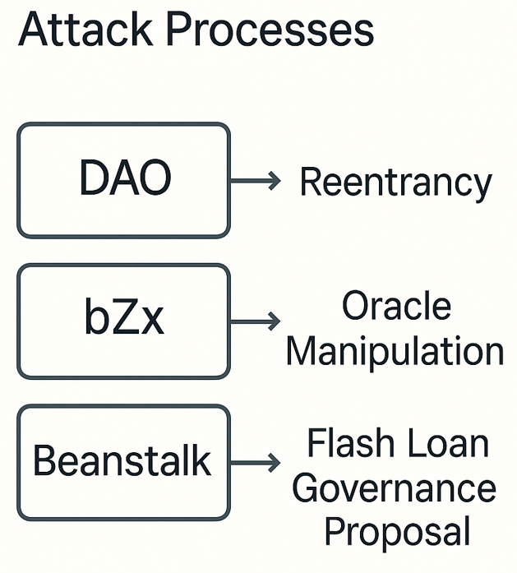
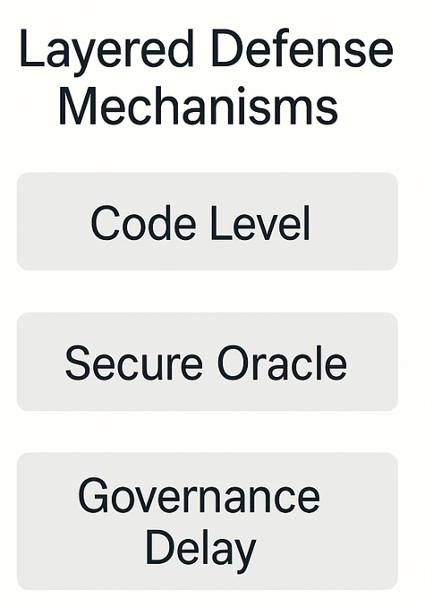
Representative Attack Cases and Defense Reflections
Most DeFi exploits reveal a lack of boundary-aware mechanisms in protocol design—particularly in oracles, governance, and access control—highlighting the absence of dynamic adversarial modeling.
Notes:
We highlighted three cases of attacks, revealing security issues in oracles, governance, and access control in DeFi protocols.
To enhance security, we suggest: contract verification, modular governance, voting delays, and incentive testing to address risks early. PPT 第3页：典型攻击案例与防御反思 🎯 标题：案例溯源与设计原则演化 📌 案例举要：
案例 类型 攻击机制 启示
The DAO (2016) 技术 重入 合约模块化 + 变更机制
bZx (2020) 经济 预言机操控 引入TWAP + 抗操纵Oracle
Beanstalk (2022) 治理 闪电贷治理提案 治理防爆机制（延迟+验证） 🎓 关键见解（学术视角）：
“多数DeFi攻击事件显示出协议设计缺乏安全边界感知机制，尤其在预言机、治理与访问控制层面，缺乏与博弈对手的动态交互建模。” 🧠 设计反思建议： • 形式化验证合约逻辑 • 模块化治理 + 投票冷却机制 • 经济激励机制仿真测试（agent-based modeling）

Slide 21
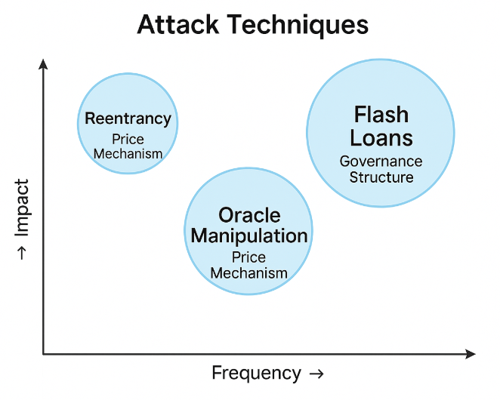
Attack Taxonomy Convergence and Economic Incentive Patterns
DeFi attacks often follow a few core patterns:
• Price manipulation
• MEV-based ordering
• Contract logic flaws
• Governance exploits.
Most are economically driven, timed around arbitrage windows or market swings.
Flash loans lower the execution threshold, enabling complex, capital-free exploits.
The pattern convergence indicates attacker maturity and automation, calling for generalizable, adaptive defenses.
Notes:
DeFi attacks fall into four main types, often profit-driven and triggered during market swings.
Flash loans let attackers act without upfront capital.
Their systematic patterns show the need for adaptive defenses. DeFi攻击通常聚焦于四类核心模式： • 价格操控， • MEV排序攻击， • 合约逻辑漏洞， • 治理机制利用。 大多数攻击以经济利益为驱动，多在套利窗口或市场剧烈波动时发起。
闪电贷大幅降低攻击门槛，使攻击者无需长期持资即可执行复杂链式操作。
攻击模式的趋同表明攻击者已形成系统性理解与自动化能力，亟需通用且自适应的防御机制应对。

Slide 22
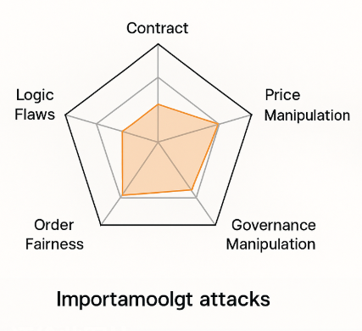
Summary of Attack Strategies and Open Challenges
From Bugs to Strategies：
Attacks now combine multiple protocols like oracles, DEXs, and lending.
Structured and Repeatable:
Clear, reusable patterns reveal deep design flaws.
Modeling for Defense：
Build multidimensional models to trace, detect, and prevent complex attacks.
Notes:
In conclusion, DeFi attacks are evolving from simple vulnerability exploits to more strategic ones. These attacks are more structured and predictable, so we need a multi-dimensional model across contracts, protocols, and time to better address these complex strategies. 攻击策略的归纳与开放挑战 “DeFi攻击正从**‘漏洞触发型’演化为‘策略驱动型’。系统性攻击模式呈现出明显的结构性**、可组合性与行为可预测性，亟需构建一个跨合约、跨协议、跨时间序列的多维策略建模框架。”

Slide 23
Contents
DeFi Primitives & Background
DeFi Arbitrage Strategies
DeFi Attack Strategies
DeFi Defenses Mechanisms
Conclusion

Slide 24

DeFi Defenses Mechanisms
DeFi protocols face unique security challenges
requiring multi-layered defenses:
Technical safeguards
Economic incentives
Governance processes
Primary threats include:
Smart contract vulnerabilities
Oracle manipulation
MEV extraction
Cross-chain attacks
Effective security requires integrated approaches
combining code, economics,
and community governance.
Notes:
DeFi protocols must defend against multiple threat vectors including vulnerabilities in smart contract code, manipulation of price oracles, extraction of value through transaction ordering, and increasingly, attacks that exploit cross-chain interactions.
What makes DeFi security particularly challenging is that no single approach is sufficient. The most robust protocols implement layered defenses that combine technical safeguards with economic incentives and community governance. This holistic approach recognizes that security emerges from the interaction between code quality, economic design, and active community oversight.

Slide 25
Smart Contract Audits & Formal Verification
This is the first Line of Defense: Code Security
Smart contract audits involve:
Manual code review by security experts
Automated vulnerability scanning
Attack scenario simulation
Formal verification provides mathematical proof of contract correctness through:
Static symbolic execution (analyzing code)
Dynamic symbolic execution (runtime behavior)
Despite advances, complete security requires both automated tools and human expertise.
Notes:
Smart contract audits and formal verification represent the foundation of DeFi security. Professional audit firms employ comprehensive methodologies that combine human expertise with automated tools.
A typical audit process includes manual code review by security experts who understand both technical vulnerabilities and economic attack vectors. This is complemented by automated scanning tools that can quickly identify common vulnerability patterns. Finally, security teams simulate various attack scenarios to test the system's resilience.
Formal verification takes security a step further by providing mathematical proof that a contract behaves according to its specifications. This can be implemented through static methods that analyze code properties without execution, or dynamic approaches that observe runtime behavior.
Despite significant advances in these tools, research shows they cannot completely replace human judgment. The most secure protocols employ both approaches, recognizing that automated tools and human expertise complement each other.

Slide 26
Oracle Security Enhancements
Goal: To Protecting the Bridge Between Chains and Reality
Oracle vulnerability solutions:
Multiple data sources with M-of-N reporter mechanisms
Time-Weighted Average Price (TWAP) implementation
Crcuit breakers for suspicious price movements
Cryptographic verification of data integrity
Oracle attacks contributed to largest DeFi exploits, making their security critical for ecosystem stability.
Notes:
Oracles represent a critical vulnerability in DeFi systems as they connect blockchain smart contracts with external data sources. According to research, insecure oracles have contributed to some of the largest exploits in DeFi history.
Several approaches have emerged to enhance oracle security. First, using multiple data sources through an M-of-N reporter mechanism allows protocols to calculate median prices and ignore outliers, making manipulation more difficult. Time-Weighted Average Price mechanisms, as implemented in protocols like Uniswap V2, track prices over time rather than using single snapshots, requiring sustained manipulation rather than momentary price spikes.
Circuit breakers provide another layer of protection by temporarily halting trading when prices move beyond predefined thresholds. Finally, advanced cryptographic verification ensures data integrity and source authenticity.
It's worth noting that no oracle solution is perfect, requiring continuous evolution as attack techniques advance.

Slide 27
MEV Mitigation Techniques
Goal: Preventing Exploitation Through Transaction Ordering
MEV (Miner Extractable Value) threatens users through:
Transaction reordering
Frontrunning
Sandwich attacks
Mitigation strategies include:
Commit-reveal schemes
Timelock delays
Fair sequencing services
Privacy-preserving transactions
Complete elimination requires aligning economic incentives across the ecosystem.
Notes:
Miner Extractable Value, or MEV, represents a significant but often overlooked threat to DeFi users. MEV exploitation occurs when miners or validators extract value by manipulating the ordering of transactions within blocks.
Common MEV extraction techniques include frontrunning, where attackers place their transactions ahead of users to capture profitable opportunities, and sandwich attacks, where transactions are placed both before and after a user's transaction to profit from price movements.
Various technical solutions have been developed to mitigate these risks. Commit-reveal schemes require users to first commit to transactions without revealing details, preventing frontrunning. Timelock delays introduce mandatory waiting periods between transaction submission and execution.
Fair sequencing services aim to create ordering mechanisms that prevent arbitrary transaction reordering, while privacy-preserving technologies shield transaction details until execution.
Research indicates that complete elimination of MEV requires not just technical solutions but economic mechanism design that aligns incentives across all participants.

Slide 28
Case Studies -> Success & Failure
Success case study: MakerDAO
Failure case study: Wormhole Bridge
MakerDAO exemplifies successful defense mechanisms in action. During extreme market volatility in 2020, its multi-layered defenses, such as governance controls, price delays, and emergency shutdowns, enabled it to maintain stability. The proactive security measures in place allowed for a swift response to emerging threats, reinforcing trust in the protocol.
The Wormhole Bridge faced a severe failure in 2022 when an exploit led to a loss of $325 million. The breach occurred due to a deprecated function that permitted forged signatures, showcasing a lapse in operational security. Despite having formal verification, the lack of adequate security measures allowed attackers to exploit the system.

Slide 29
Contents
DeFi Primitives & Background
DeFi Arbitrage Strategies
DeFi Attack Strategies
DeFi Defenses Mechanisms
Conclusion

Slide 30
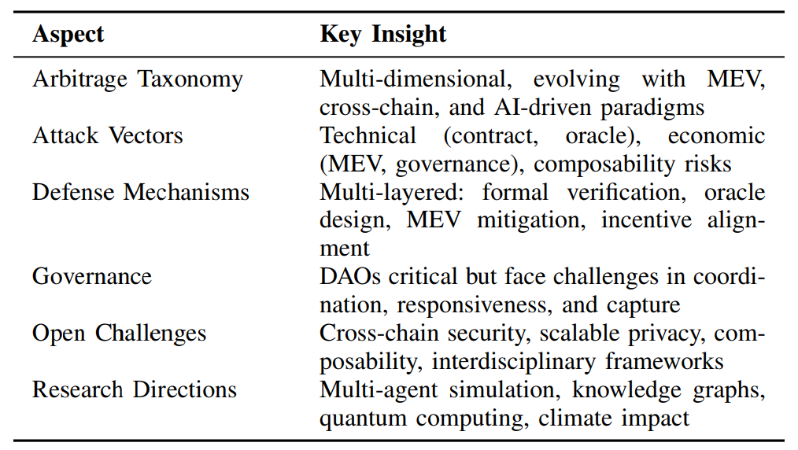
Conclusion

Slide 31

Thank You !
Q & A

